Slide 1

Artificial Intelligence-driven Weed Management and Sustainable Farming
Presented by:
Engr. Jibril Abdullahi Bala
Department of Mechatronics Engineering,
School of Electrical Engineering and Technology,
Federal University of Technology Minna.
Notes:
NOTE:
To change the image on this slide, select the picture and delete it. Then click the Pictures icon in the placeholder to insert your own image.

Slide 2

About the Presenter
Jibril Abdullahi Bala
B.Eng., MSc., MNSE, MNIEEE, MIEEE, R.Engr.
Team Lead, Autonomous Vehicles, Autotronics and Control Unit, Advanced Engineering Innovation Research Group
Faculty Member, Department of Mechatronics Engineering,
Federal University of Technology, Minna, Nigeria
Senior Research Fellow, Summit University Offa, Kwara State
Area of Specialisation
Intelligent Control Systems
Computer Vision
Autonomous Vehicles
Precision Agriculture
Contact
jibril.bala@futminna.edu.ng
+2348137125837

Slide 3





Presentation Outline
Introduction
Overview of AI in Weed Management
Related Works in AI Based Weed Control
Open Areas and Challenges for Women Farmers
Conclusion

Slide 4
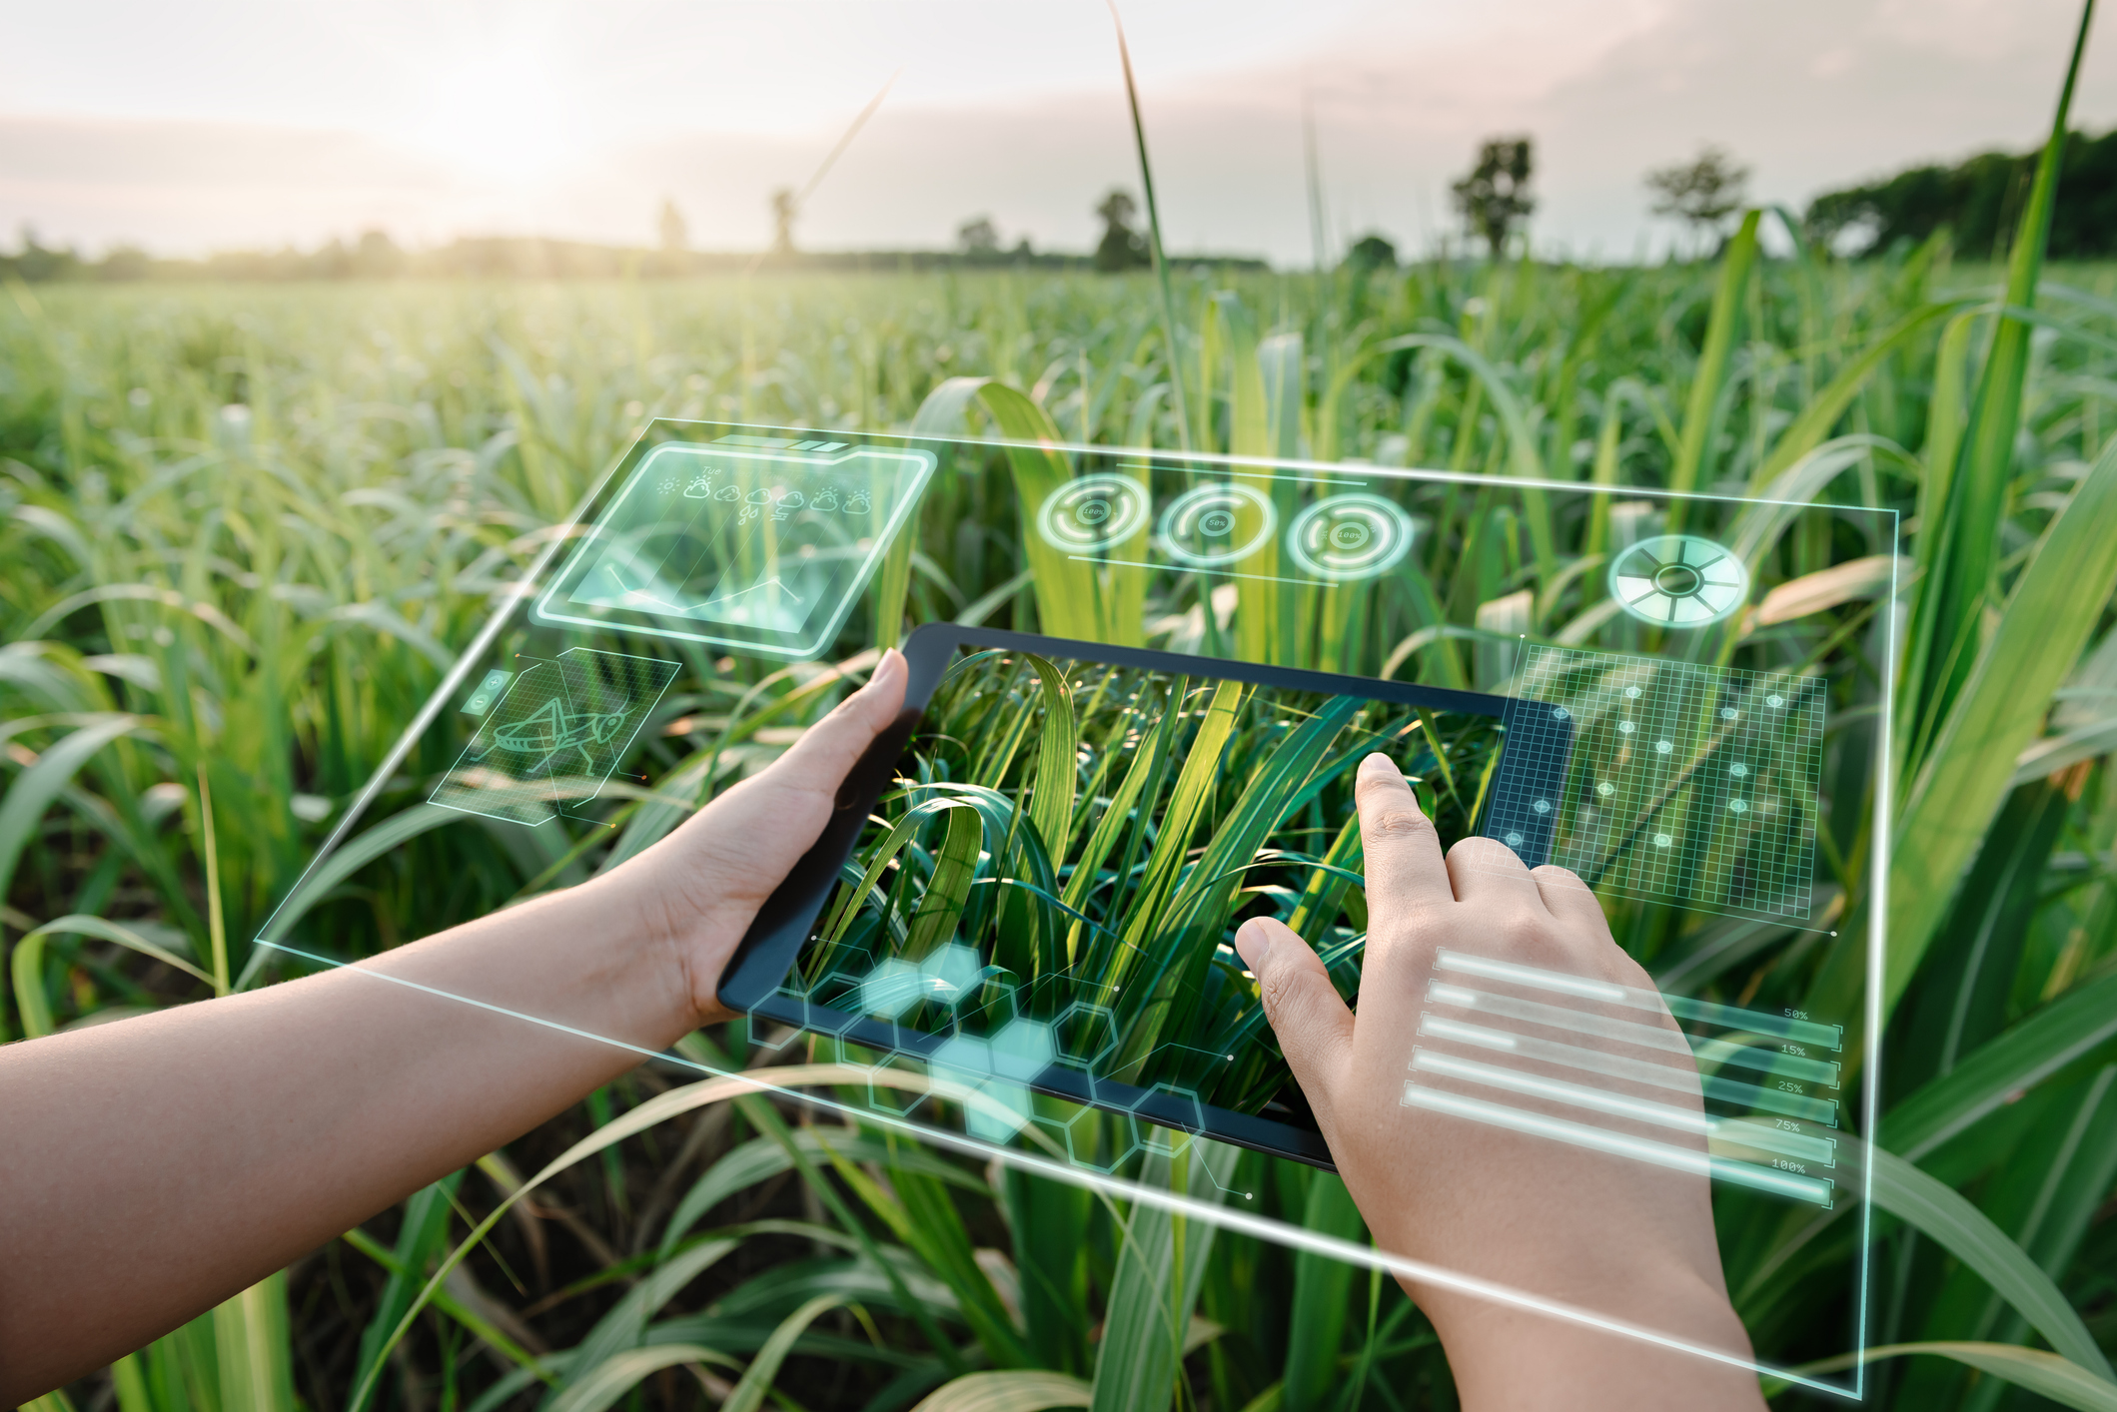
Introduction
In recent times, Artificial Intelligence (AI), which was once relegated to the realms of futuristic and speculative discussions, has swiftly cemented its relevance in the world of modern agriculture (Liang and Shah, 2023).
By weaving AI's capabilities with traditional farming techniques, we're not only paving the way for innovative strategies but also ensuring that these strategies resonate with our global pursuit of a greener and more sustainable future for farming (Taylor, 2018).

Slide 5
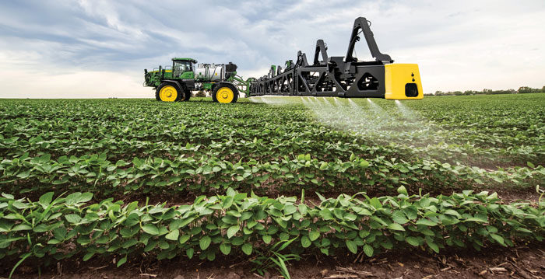
Introduction (cont.)
At the heart of this extensive agricultural evolution is the strategic focus on weed management.
Addressing and mitigating weed challenges involves more than just immediate crop protection.
By doing so, it yields dual benefits: a significant uptick in agricultural sustainability, ensuring long-term soil health and ecological balance, and a marked enhancement in farming efficiency, optimizing yields and resource utilization (Salaudeen et al., 2022).

Slide 6
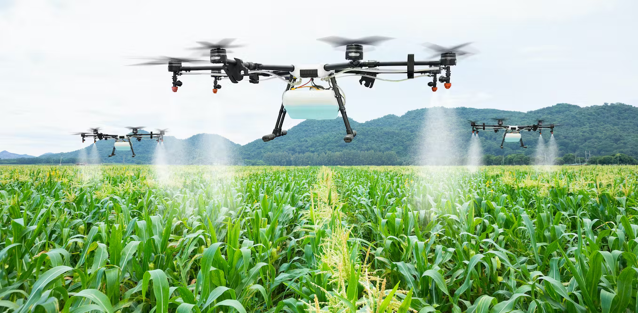
Overview of AI in Agriculture
AI in Weed Detection:
Optimisation Algorithms
Deep Learning Algorithms
Transfer Learning
Image Segmentation Techniques
Reinforcement Learning
Object Detection Models
Feature Extraction Techniques

Slide 7
Overview of AI in Agriculture
Embedded Systems, Sensors, and Real-Time Data Processing:
Intelligent Sensors
Computer Vision
Robotics
Internet of Things
ML based Prediction
UAVs and UGVs

Slide 8
Related Works in AI Based Weed Control
Author | Work | Technique | Observation
Olanyi et al., (2021) | Identifying and pinpointing weeds in lowland rice farming settings | SSD and VGG-16 | SSD: accuracy of 86%, sensitivity of 93%, and precision of 84%
Costello et al., (2022) | Identify and map parthenium weed populations using RGB and hyperspectral imagery coupled with artificial intelligence | YOLOv4 CNN model and XGBoost Classifier | The YOLOv4: 95% detection accuracy and 86% classification accuracy. XGBoost: 99% classification accuracy.
Subeesh et al., (2022) | Deep learning techniques in automating weed identification | Alexnet, GoogLeNet, InceptionV3, and Xception | Models achieved accuracy rates ranging from 94.5% to 97.7%

Slide 9
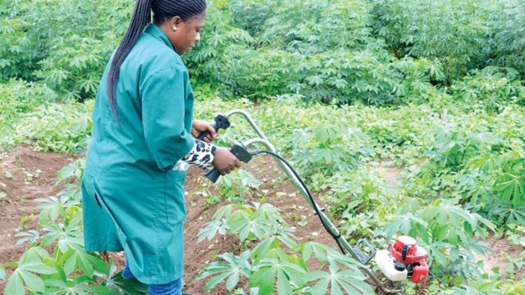
Open Areas and Challenges for Women Farmers
Land Ownership and Inheritance Issues (Onwutebe, 2019).
Financial Constraints (Ugwu, 2019).
Limited Access to Quality Inputs and Training (Amusan et al., 2021).
Gendered Labour Expectations (Ugwu, 2019; Amusan et al., 2021).
Vulnerability to Climate Variabilities

Slide 10
Our Contributions
In Weed Detection
Weed Detection in lowland rice farms (using SSD and VGG-16)
Weed Detection in Maize Farms (Using YOLO v4 and Tiny YOLO v4)
Other Aspects of Agriculture
Poultry Feed Dispensing using Artificial Intelligence
Intelligent Robotic Navigation in Farms
Intelligent and Optimised Control of Robotic Motors and Servos
Machine Learning Based prediction and Intelligent Control for Aquaculture Systems

Slide 11
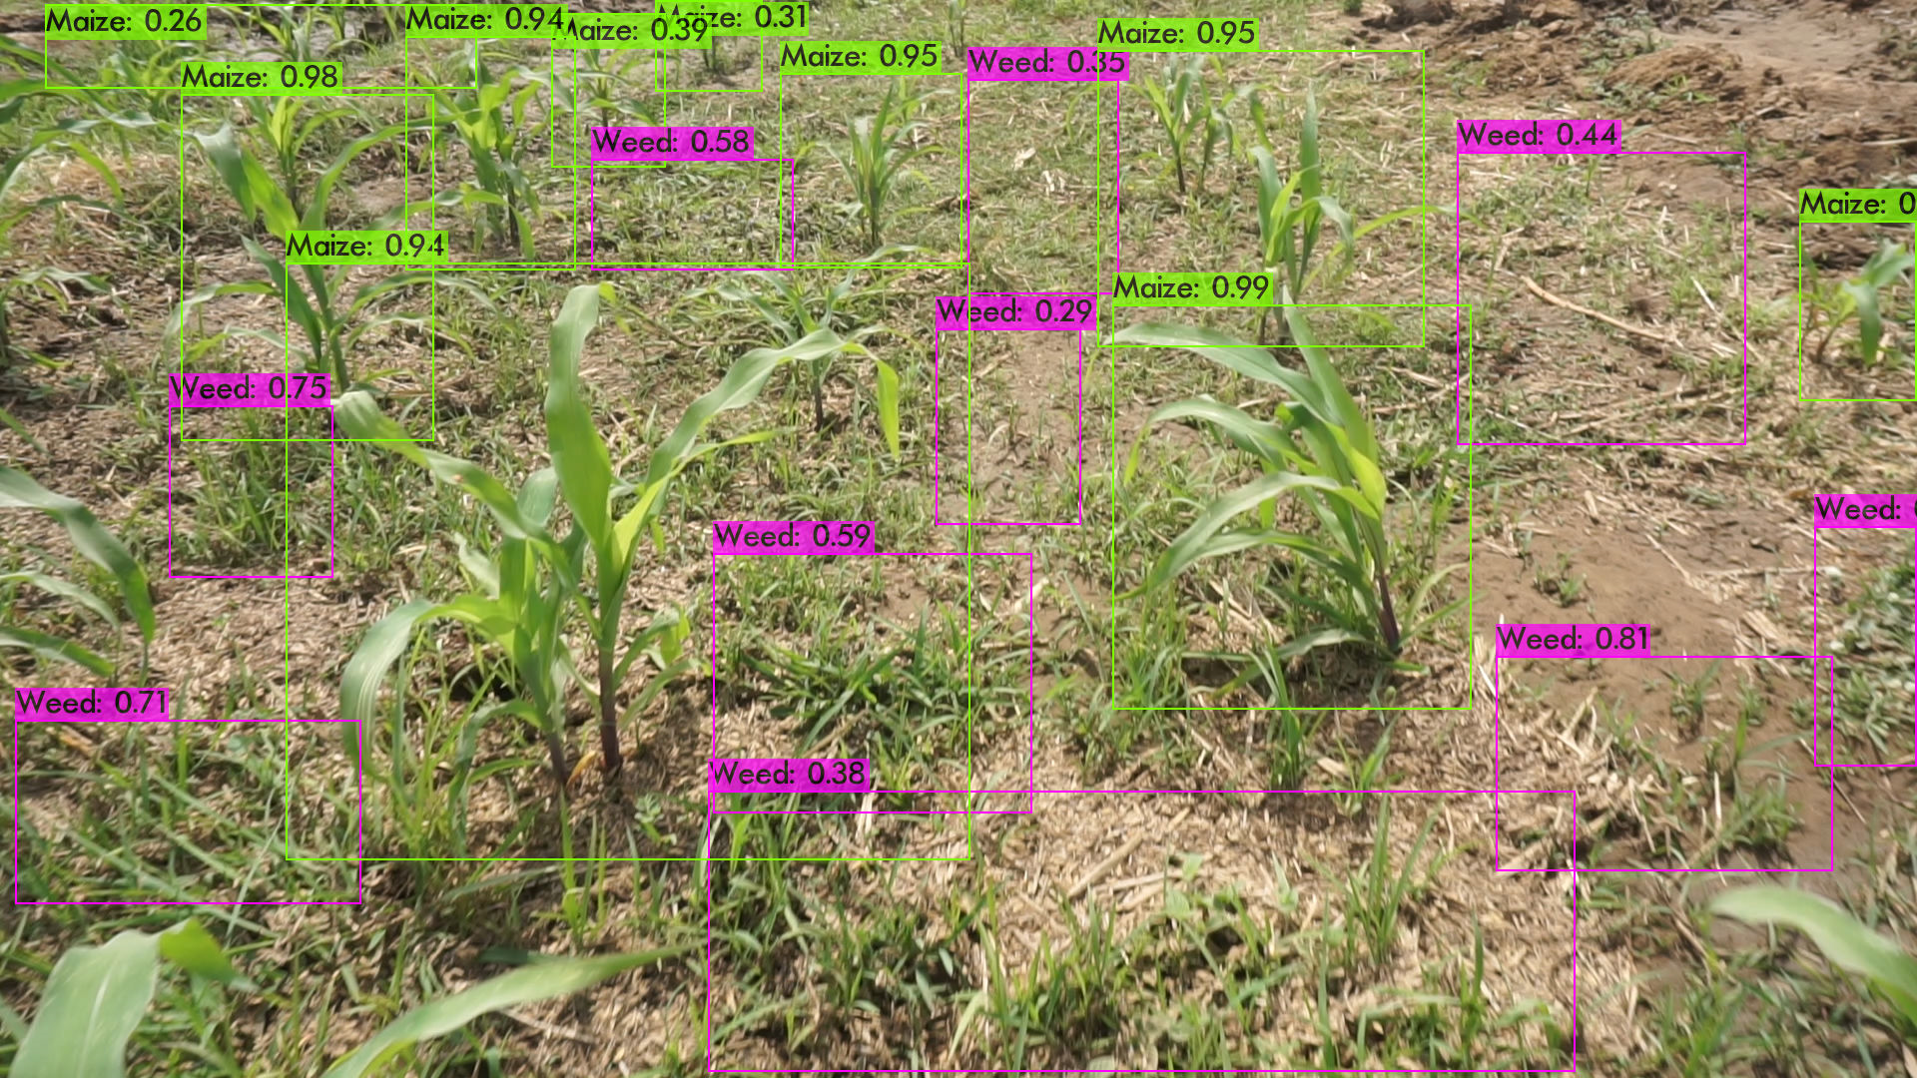
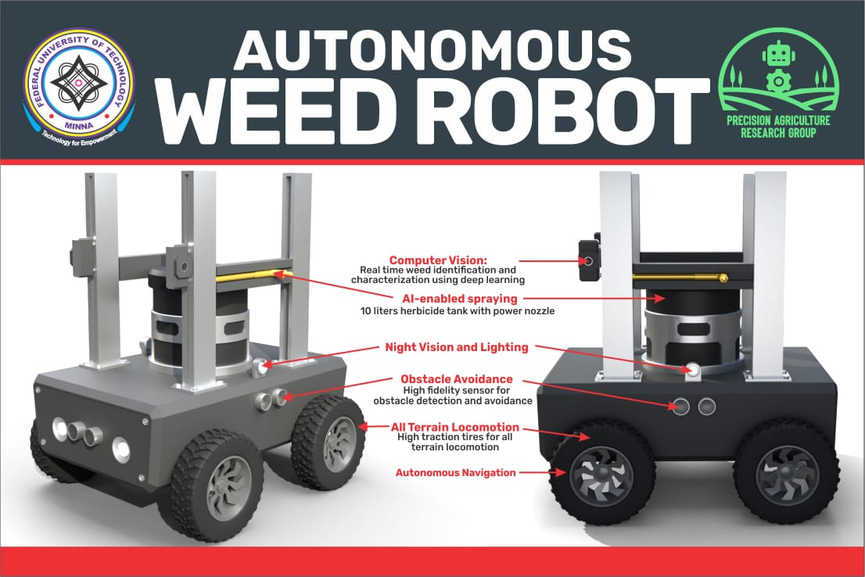
Our Contributions
Weed Detection using Deep Learning
Autonomous Weed Detection Robot

Slide 12
Conclusion
The integration of Artificial Intelligence in agriculture, specifically in weed management, has shown the potential to revolutionize traditional farming practices.
This research paper, drawing from the vast landscape of agriculture in Nigeria, unveiled the transformative capabilities of AI-driven tools, especially their alignment with sustainable farming goals.
More poignantly, this investigation highlighted the unique challenges and opportunities faced by women farmers in Nigeria, a demographic that remains integral yet underserved in the agricultural narrative.
As we envision the future of agriculture in Nigeria, this blend of technology, sustainability, and inclusivity sets the stage for a promising future in Nigerian agriculture.

Slide 13



jibril.bala@futminna.edu.ng
+2348137125837

